Slide 1
Dynamic Scheduling and Division of Labor in Social Insects
Paper By: Mike Campos, Eric Bonabeau, Guy Théraulaz, and Jean-Louis Deneubourg
Summary and Review By: Brett Belcher

Slide 2
Overview of presentation
Summary
Introduction
Description of Problem
Market-Based Algorithm
Ant-Based Algorithm
Determining Free Parameters (Genetic Algorithm)
Results
Conclusion
Review
Strengths
Weaknesses
Extensions

Slide 3
Introduction
How do we efficiently assign tasks or resources dynamically?
Analyze the Dynamic Flow Shop Scheduling Problem with two algorithms
Market-Based Algorithm
Ant-Based Algorithm
Purposes of this paper
Show feasibility of a robust scheduling algorithm inspired by task allocation in social insects (ant-based algorithm)
Highlight the similarities between a market-based approach and ant-based approach
Motivation of this paper
Introduce the idea that ant-like agents are highly useful in distributed heterogeneous problems
Introduce a possible improvement on a proprietary optimization algorithm

Slide 4
Description of problem
Assign trucks to paint booths
Each booth can only paint a specific color at a given time
For a booth to change the color it can paint, the booth must flush all its paint
This takes 3 minutes
The color a truck is to be painted is predetermined when it is assembled
It takes 3 minutes to paint a truck
Trucks come off the assembly line once every minute
For seven straight hours in our simulation yielding 420 trucks
Number of booths is a variable
Maximum queue for a booth is 5 trucks
There is a random chance that a booth at any given time step can become inoperable for a random amount of time

Slide 5


Market-based algorithm
A system developed by Morley [1] introduced a set of simple rules each booth was to follow when bidding:
Prioritize trucks to be painted with the booth’s current color
Prioritize jobs with higher priority
Take jobs to stay busy
Do not take a job if the booth is currently inoperable
Time to Paint Function [2]
Bidding Function [2]

Slide 6
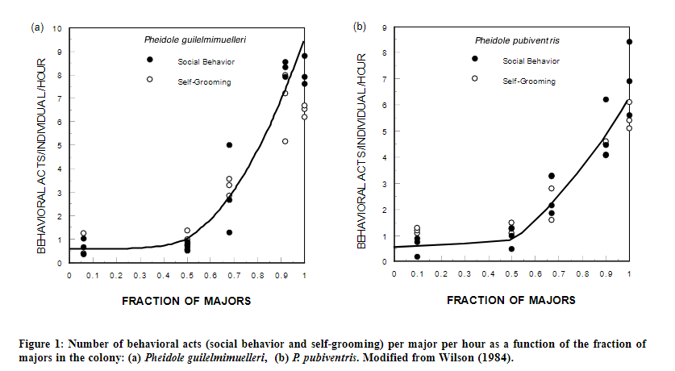
Ant-based algorithm background
Specialization in ant colonies are flexible
Two classes of ants: Minors and Majors
Minors tasks include
Day to day tasks like self-grooming
Majors tasks include
Seed milling, food storage, and defense
Minor tasks done by majors as a function of majors in the population [2]

Slide 7




Ant-based algorithm
The biological inspiration here is task specialization
A global demand for each color j is calculated as follows [2]:
The strength of response of a booth, k, to respond to a truck of color, i, is [2]:
Thresholds are updated as follows [2]:
Global Demand Function [2]
Response Tendency Function [2]
Local Threshold Change [2]
Global Threshold Change [2]

Slide 8
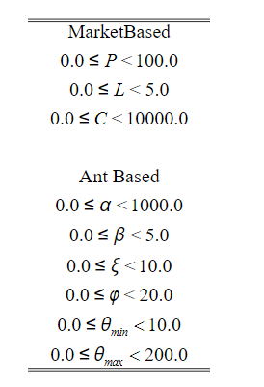
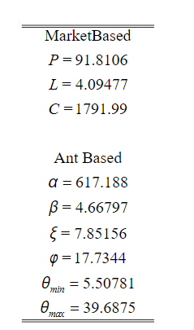
Determining free parameters
The market-based algorithm has 3 free parameters that need to be defined
P, C, and L
The ant-based algorithm has 6 free parameters that need to be defined
α, β, ξ, φ, θ_{min}, and θ_{max}
A genetic algorithm procedure was used to determine the optimum values
Parameters and their bounds [2]
Optimum values for parameters as determined by genetic algorithm [2]
Notes:
Fitness was determined in the first 50 generations by time then in the last 50 by minimum number of flushes
The GA was run over four test sets

Slide 9
results
Four test sets were used to determine the results of both algorithms
Test Set 1
Equal probability distribution of each color truck occurring
One truck at a time
Booth down probability (0.05)
Test Set 2
Same as Test Set 1 except for color distribution
Black (70%), white (15%), red (7%), blue (4%), other 16 colors share (4%)
Test Set 3
Same as Test Set 2 except two trucks at a time
Test Set 4
Same as Test Set 3 except booth down probability (0.25)

Slide 10
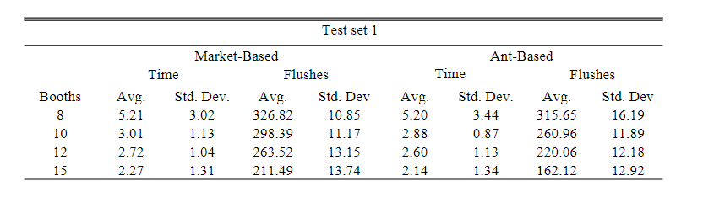
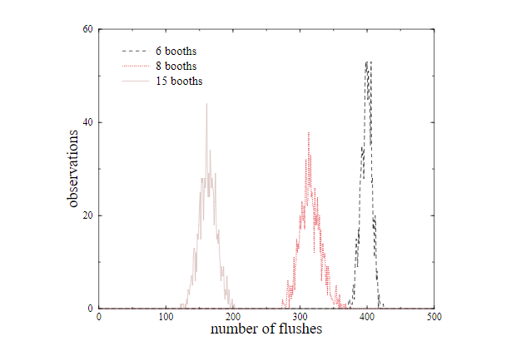
Test set 1
Flush histogram for different numbers of booths (15, 8, 6) [2]
Notes:
Test Set 1: Better on flushes

Slide 11
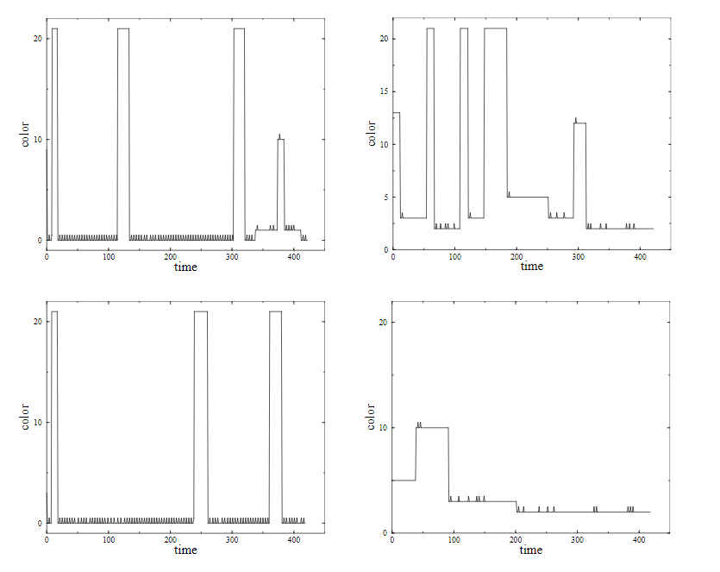
Test set 2
Graph of 4 random booths during Test Set 2 [2]
Notes:
Test Set 2: Shows specialization of booths
Booth number 21 indicates inoperable state

Slide 12
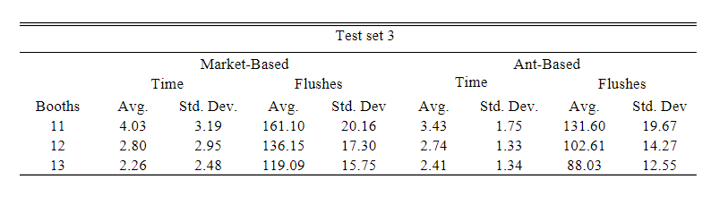
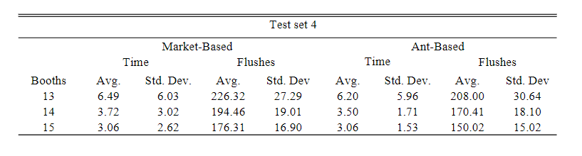
Test sets 3 & 4
Results of Test Set 3 [2]
Results of Test Set 4 [2]
Notes:
Test Set 3: Better Flushes
Test Set 4: Similar on both

Slide 13
conclusion
Task allocation used by social insects could be utilized as a dynamic scheduling algorithm
Given the Dynamic Job Scheduling Problem task specialization helped mediate the number of flushes required in half of the test cases by a substantial amount
Social insect type agents provide a meaningful advantage for distributed heterogeneous problems

Slide 14
Review – strength one
Mathematical rigor
The functions and definitions used provide a compulsory description of how each algorithm functions at every step of its process
The functions provided translate intrinsically to computer code
Notes:
Repricatable

Slide 15
Review – Strength two
Testing and comparing algorithms over varying “outside” parameters
Provides a more “real world” analysis to comparing the two algorithms
This is because some parameters that will hinder the performance of one algorithm but not the other are sometimes outside the scope of the algorithms themselves
These multiple test sets show that these outside parameters did not show a negative effect to the ant-based algorithm

Slide 16
review – strength three
The plan to optimize parameters rather than chalking them up as more ad hoc decisions
Determining optimal parameters is a computationally heavy task
Using the same genetic algorithm to determine the optimum parameters for both over the four test sets created a “level playing field” where one algorithm wasn’t given an unfair advantage based on its parameters

Slide 17
Review – weakness one
Ad hoc choices in the market-based algorithm
There could have been optimizations in Morley’s algorithm that would minimize the number of flushes needed
While Morley’s algorithm is protected, there was no effort to explore the possibility of specialization that would help mitigate the needed amount of flushes
Notes:
These optimizations could yield an algorithm that performs better than the ant-based algorithm in all cases

Slide 18
Review – weakness two
Fitness and tournament in the genetic algorithm
These features of the genetic algorithm that are pivotal to its success at determining optimality were calculated seemingly arbitrarily
No citation or explanation was given to why they were determined in this way
Notes:
Single point of failure

Slide 19
Review – weakness three
The priority variable
While this variable was significant in calculating the booth’s propensity to respond to a truck, it was ignored from descriptions or parallels to the task allocation process performed by social insects
Notes:
The conclusion is that social insects provide a model that provides a strong dynamic task allocation algorithm, but does it?
Should we not conclude that maybe the social insects provide optimizations but not the algorithms

Slide 20
Review – extension One
Different kinds of booths
What if we added more booths, but ones that ran on different rule sets than our original booths
What optimizations could be found from these different booths that may minimize our time or flushes

Slide 21
Review – extension two
Parallel Process Scheduling
Consider
Each processor as a booth
The paint of a booth being the cache closest to that processor
Minimize the amount of paint flushes (cache misses and memory calls) by specializing each processor to utilize a given segment of memory already in cache

